Slide 1




Transforming the World's Largest Financial Market
OMeT brings structure to cleared swaps trading: An open electronic market in place of a fragmented relationship-driven execution.
OMeT is an anonymous, all-to-all execution venue purpose-built for the cleared OTC swaps market.
Ride the Wave of Change
Every rule visible. Every outcome explainable.
Every trade turned into intelligence.
CONFIDENTIAL · INVESTOR PRESENTATION · NON-NDA
SEPTEMBER 2026
Notes:
Position OMeT as market infrastructure: a regulated, long-duration asset rather than a trading strategy. Family offices respond to durability, alignment, and a clear path to cash flow.

Slide 2


THE OPPORTUNITY
Every major asset class has transformed electronically. Swaps are next.
$590 Trillion
Markets migrate toward transparency, automation, open access, and lower friction.
OMeT has built the market structure layer for the world's largest asset class.
*OTC interest rate derivatives notional outstanding, 2025
$7.9 Trillion
* Average daily OTC interest rate derivatives turnover, 2025
The world's largest participants demand efficiency: tighter pricing, open access, and anonymous execution. OMeT delivers.
Sources: *BIS Triennial Central Bank Survey, April 2025 (turnover); ISDA analysis of BIS OTC derivatives statistics, H2 2025 (notional).
CONFIDENTIAL · INVESTOR PRESENTATION · NON-NDA
SEPTEMBER 2026
Notes:
Clearing removed the credit reason for relationship-based execution, but the execution model never caught up. The scale of the market means even a small share of addressable volume is meaningful. Add your addressable-volume and share assumptions here if you want the revenue math on this slide.

Slide 3


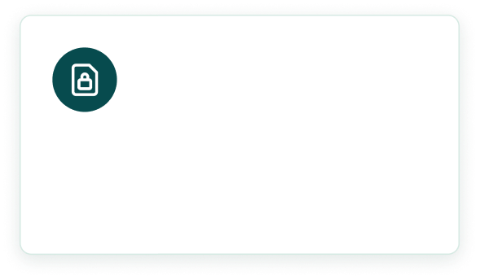



WHY NOW, WHY OMeT
The modernization of this market was inevitable.
The only question was when. The answer is now.
Regulation favors our model
The Clearing Mandate
Neutral by design
CFTC rules on impartial access and anonymous cleared execution support the OMeT model.
Central clearing is now the market standard.
Rules-based access with no favored relationships aligns OMeT with every participant.
OMeT fills the demand.
CONFIDENTIAL · INVESTOR PRESENTATION · NON-NDA
SEPTEMBER 2026
Notes:
Timing plus defensibility in one slide. If OMeT is independent of dealer ownership, say so under 'Neutral by design'; it's the strongest version of that point.

Slide 4



OMeT is the solution
Participants are now demanding an open neutral access to liquidity.
The conditions to deliver are in place for a target launch in January 2027.
Regulation in our favor
01
CFTC rules on impartial access, transparency and anonymous cleared execution support the model.
02
The technology exists
Platform built and ready to launch upon CFTC approval, anticipated in November 2026.
03
Market ready
Clearing, reporting and SEF infrastructure are already in place.
04
Scalable strategy
OMeT's model travels: the same rules and protocol can serve cleared markets worldwide.
Partnerships to execute
05
OMeT is collaborating with the world's largest clearinghouses, CME and LCH, along with OSTTRA, the premier pre and post trade services provider for institutional trading.
06
Client support
30+ of the largest institutional participants are currently in the process of onboarding.
07
A Protected Protocol
eMOD’s three-phase protocol is patent-pending.
CONFIDENTIAL · INVESTOR PRESENTATION · NON-NDA
SEPTEMBER 2026

Slide 5

















THE SYSTEM
OMeT is the “glass box” for the OTC markets: Transparent Institutional Infrastructure for execution, clearing connectivity and intelligence, where every rule is visible and every trade compounds.
OMeT Exchange: Rules based exchange for all-to-all cleared swaps.
eMOD
A patent-pending three-phase protocol structuring how participants interact.
1
ORP
Open Request Phase: Participants submit requests for soliciting quotes with the intent to trade.
One connected system, not a feature collection.
2
OMP
Open Market Phase: Participants submit orders to trade in live markets.
3
OMM
Open Mid Match Phase: Participants submit an order at a system generated mid for matching.
OWA-i
Interaction creates data.
Intelligence creates value.
01 · EXECUTION
02 · PROTOCOL
Audit trail and data Intelligence Waterfall.
03 · WORKFLOW
04 · INTELLIGENCE
OMeT Intelligence: AI-powered data services that analyze and deliver insights, analytics and decision support to market participants.
CONFIDENTIAL · INVESTOR PRESENTATION · NON-NDA
SEPTEMBER 2026

Slide 6















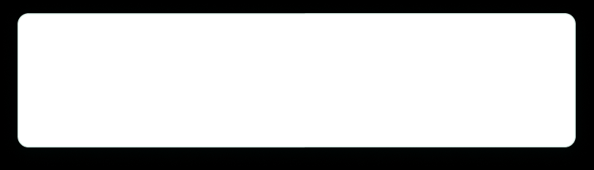


BUSINESS MODEL
The model does not change as OMeT scales.
Participation and volume Do.
More participants
Exchange fees
Transaction fees on every trade executed on OMeT-X.
Better Intelligence
THE OMeT FLYWHEEL
More volume
Data and intelligence
OMeT-i subscriptions: analytics, insights, and decision support built on venue data.
More data
CONFIDENTIAL · INVESTOR PRESENTATION · NON-NDA
SEPTEMBER 2026
Notes:
Two confirmed revenue engines: execution and data. The flywheel is the long-term story: more participants bring more volume, which produces more data, which improves OMeT-i, which attracts more participants. Fill in fee structure and pricing before sharing.

Slide 7


Launch where the opportunity is greatest. Scale from there.
STAGE 1
STAGE 2
STAGE 3
Mexico + Chile
Emerging Markets
Global Markets
$37 Billion daily trading opportunity.
LATAM, Asia, Eastern Europe.
The major currencies:
Dollar, Euro, Pound.
$105 Trillion addressable swap market.
Minimal electronic competition.
The $590 Trillion market fully realized.
Strong demand for anonymous execution.
CONFIDENTIAL · INVESTOR PRESENTATION · NON-NDA
SEPTEMBER 2026

Slide 8

OMeT applies practitioner knowledge from the market's previous generation to the infrastructure the next generation requires.
“Our team brings decades of derivatives experience: running brokerage desks and bank trading operations, building matching engines, and working within CFTC and CCP governance. We came from inside this market. That's why what we have built connects directly to the systems it already runs on.”
Vinayek Singh
‍Chief Executive Officer
v.singh@om-etrading.com
(P) +1-917-403-0300
OMeT is engaging select investors ahead of commercial launch and global expansion.
This presentation contains forward-looking statements, including anticipated regulatory approvals, launch timing, partnerships, and market opportunity. These reflect current expectations and are subject to risks and uncertainties; actual results may differ materially.
CONFIDENTIAL · INVESTOR PRESENTATION · NON-NDA
om-etrading.com
SEPTEMBER 2026

